Slide 1


Accessible content creation
Learn to Enable Digital for Everyone
www.LearnToEnable.co.uk

Slide 2
This session will cover
Discussing examples of accessible content
A mini workshop of some simple concepts
What could be your one accessible thing to take away and apply?
Handouts www.learntoenable.co.uk/sgs

Slide 3



Let’s start with a quick question…
What digital content have you created this week and how often?
Documents/Presentations
Posters
Emails
Social media posts
Video content
VLE/Intranet
Web content

Slide 4
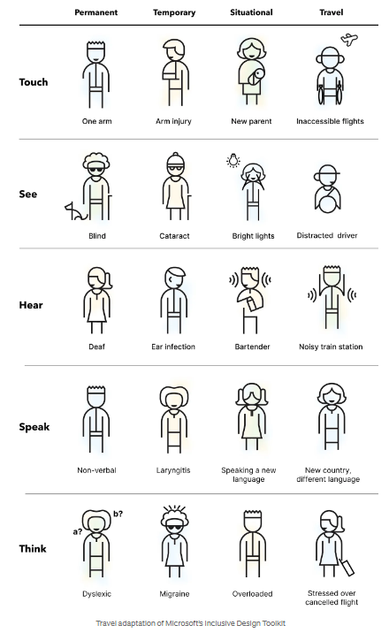
Helping you to help others
All of us can make content accessible:
There are some very basic everyday principles that everyone can learn and apply
Universal design thinking in a digital world
Some everyday examples…

Slide 5
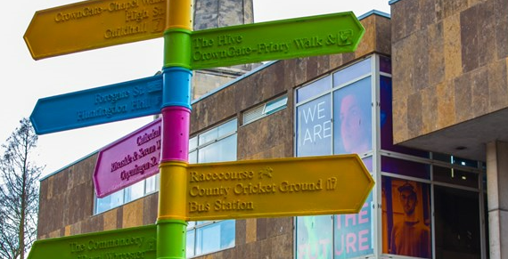
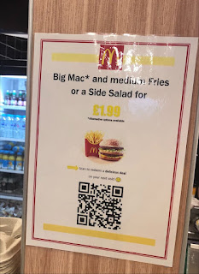
Examples to discuss…
Everyday digital content examples:
Relying on colour
  Turtles / Dots / Snacks
When images don’t load – alt text
  Fire assembly examples
Headings, links and alt
  Compare 2 examples
Colour contrast
  Word search and brand colour examples
Do you ever post on social media?

Slide 6
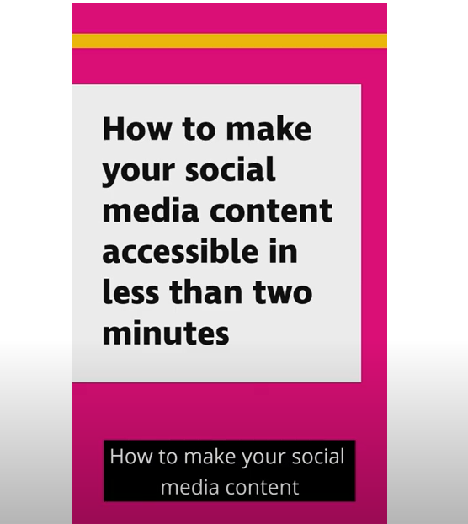
Simple concepts to take away…
Watch the 2-minute RNIB Social Media Video
Simple social media tips to takeaway:
  CamelCase hashtags
  Appropriate use of emojis
  Alt text examples

Slide 7
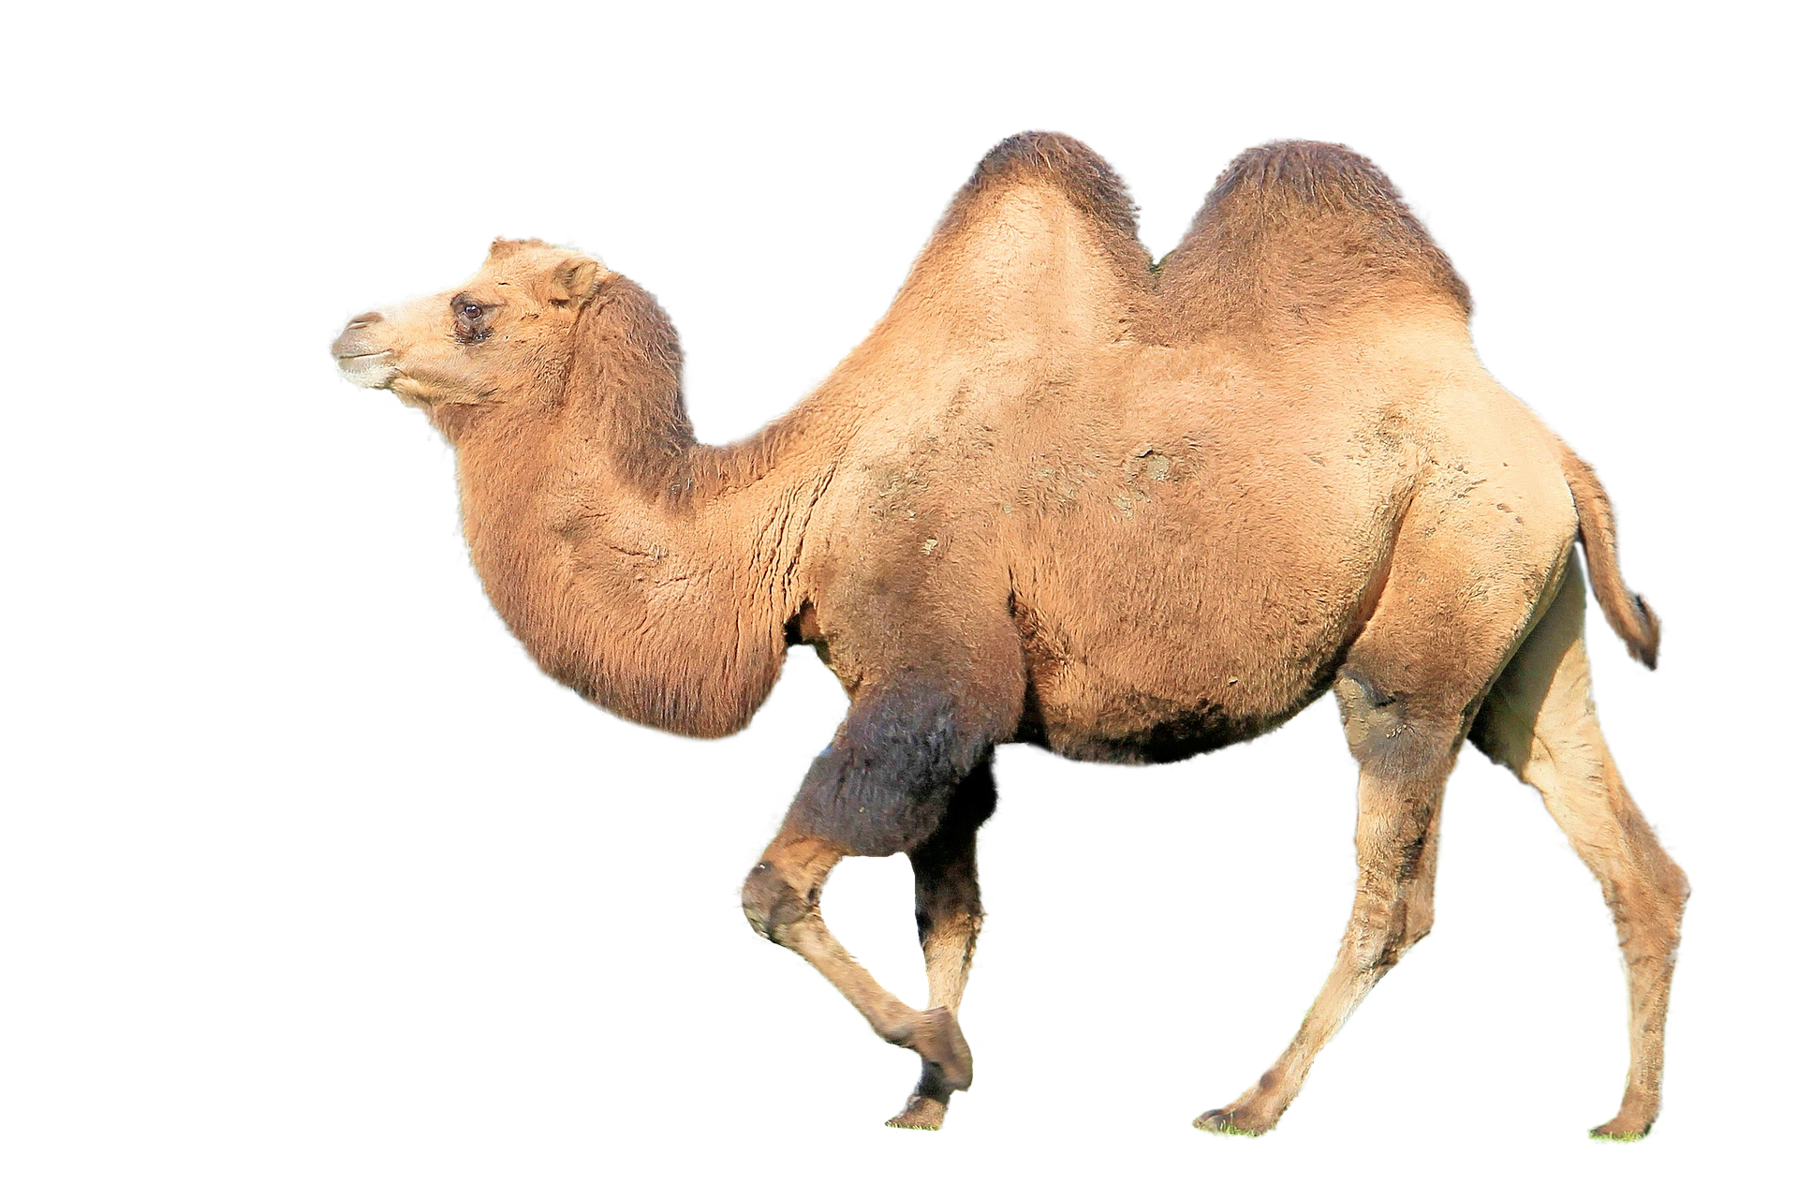
PascalCaseHashtags

Slide 8
camelCaseHashtags

Slide 9
How might hashtags get accidentally interpreted?
Why are CamelCase hashtags more accessible?
#lotsofwordscrashedtogetherisdifficulttoread
Hashtags is one small thing for accessibility you can very easily adopt
A hashtag demonstration
!Language warning!

Slide 10

How might these get accidentally interpreted?
#davistherapists
#DavisTherapists
#powergenitalia
#PowergenItalia
#whoremembers
#WhoRemembers
#susanalbumparty
#SusanAlbumParty

Slide 11

Emojis as bullet points
Avoid using emojis instead of bullet points:
We acknowledge that the conversation about menopause transition in the workplace:
Finger pointing is valid
Finger pointing is required
Finger pointing in necessary

Slide 12
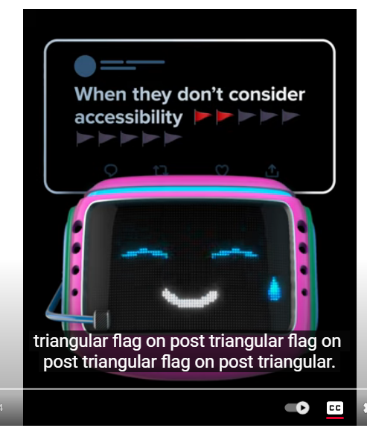
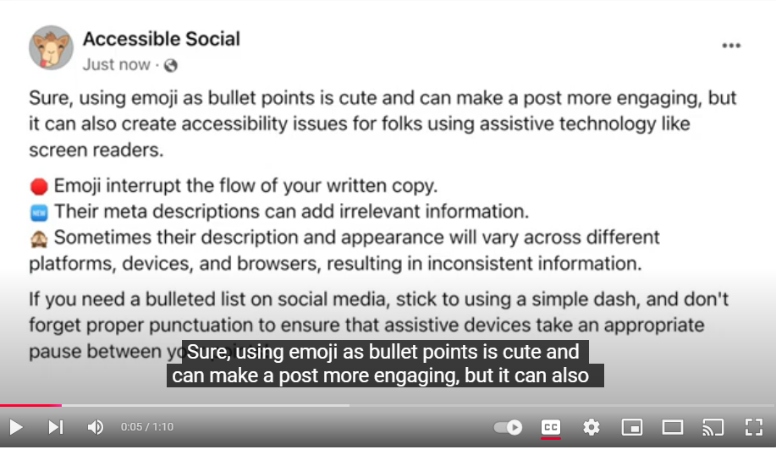
Emoji examples – have you ever done this?
Emoji bullet points
Emoji overuse

Slide 13

Web accessibility
What if I said I could teach you how to do a big part of job in just a couple of minutes?
Tab / shift / arrow keys / enter / spacebar
NHS Website
Health website
Inclusion website
College website

Slide 14

What one tip will you take away and apply?
Thank you for attending!
Any questions?

Slide 15

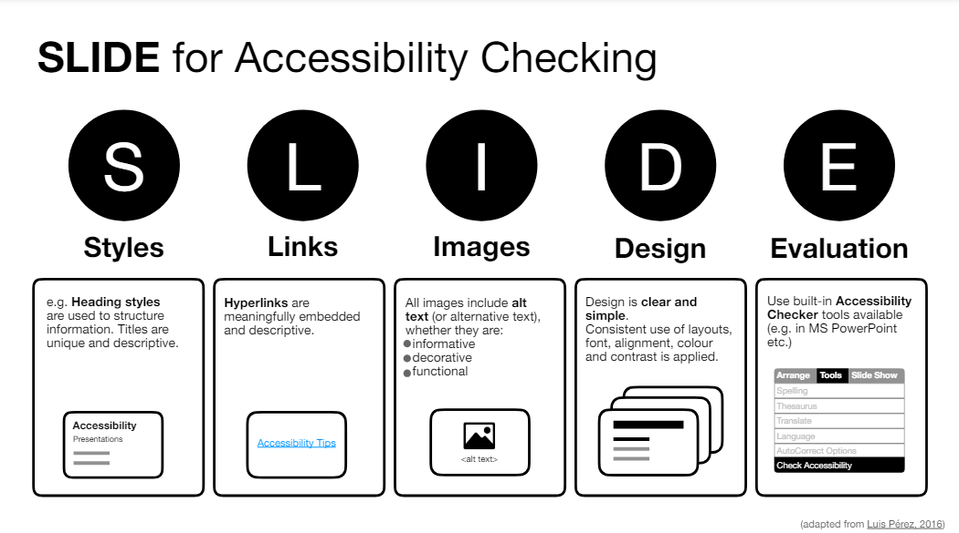
Extension workshop activity
Workshop templates: www.learntoenable.co.uk/sgs
  Word document checker and demonstration
  PowerPoint infographic checker and demonstration
  Headings in tables

Slide 16
Why awareness is important:
The accessibility checkers don’t cover everything - PowerPoint:
It covers | It does not cover
Titles | Descriptive hyperlinks
Alt text on images | Use of fonts or capitals
Alt text on shapes | Colour contrast of text and background
Reading order | The amount of content on slides or clear language
Items that are grouped | Grouped items, text in shapes for exporting to PDF
Tables – merged and split cells | Images of text

Slide 17
The Word accessibility checker also does not cover everything:
It covers | It does not cover
Colour contrast | Descriptive hyperlinks
Alt text on images | Use of fonts, alignment or capitals
Items not inline | Clear language
Note: Headings are in a different part of the checker | Headings are in navigation pane
Tables – merged and split cells | Grouped items (PDF implications) Text boxes (PDF implications)
Reading order | Images of text

